Slide 1
PREDICTING THE PROBABILITY OF SEVERE ACCIDENTS BASED ON WEATHER CONDITIONS
By Andi Frkovich
September 17, 2020

Slide 2
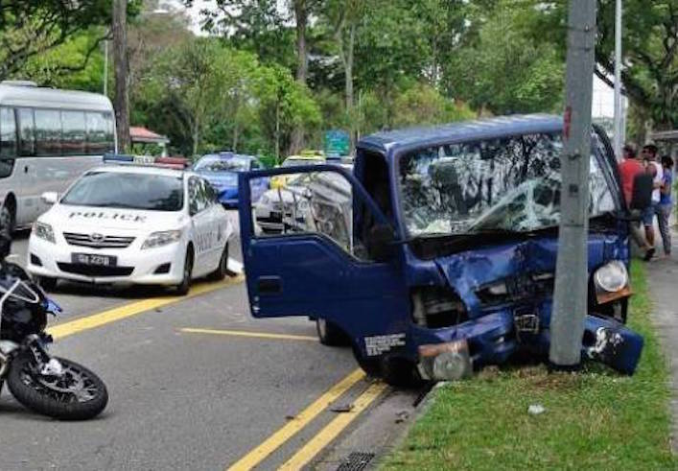
Part I: Introduction
Aim of Study: Understand the extent to which poor weather conditions can be used to predict traffic accident severity
Target Audience: Seattle Police Department (SPD)
SPD responds to accidents and coordinates necessary medical care
Police could use predicted severity of traffic accidents to optimize manpower and resource allocation (specifically to traffic units)
Helpful data:
meteorological weather
road conditions
light conditions
Others who may be interested in the data:
local hospitals, which can use the information to optimize staffing and equipment availability
local news and public health organizations, which could leverage the information to issue timely health warnings to the public.

Slide 3
Part II: Data Acquisition & feature selection
Data pulled from Kaggle dataset located ​here​.
Target variable: Severity Code
Features Selection
numerous features that feed into the ‘severity code’ attribute were not kept, as they are already reflected in the resultant ‘severity code’
Administrative features dropped
Final set: 194,310 features and four attributes.

Slide 4
Part II: data cleaning
Data problems and solutions
Problem: various attributes were over-weighted to certain outcomes
Solution: decrease the weighting of those particular outcomes and normalize the dataset
Problem: Data is descriptive, vice numeric
Solution: converted descriptive data (i.e., ‘dry road’) to numeric data where the number assigned corresponds to the severity of conditions
Problem: features missing data
Solution: features missing data were dropped. 194,310 attributes remained, a very robust n sample.
No significant outliers found

Slide 5
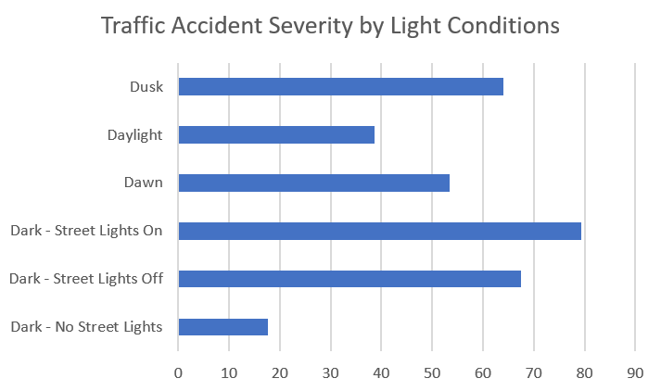
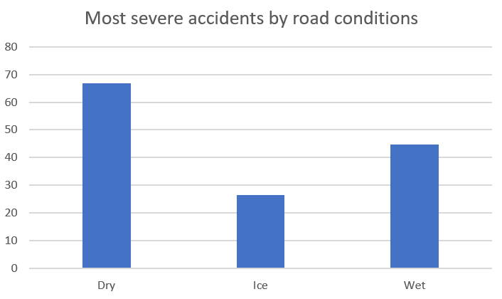
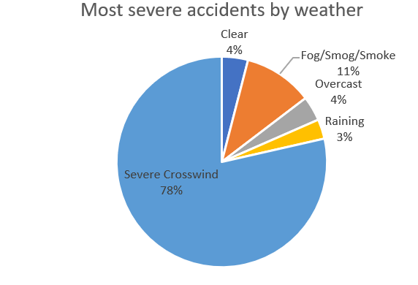
Part III: data exploration

Slide 6
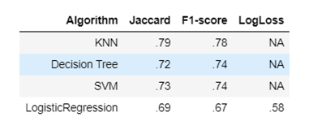
Part iII: methodology & predictive modelling
Classification models are best suited for probability predictions. This study used:
K-Nearest Neighbor model
Decision tree model
Logistic Regression model
SVM model
Primary Evaluation Metrics:
Jaccard
F-1 Score
Log Loss for Logistic Regression
To apply these models, I had to:
Convert categorical to numeric values
Account for over-representation
Divide the data into two severity classes (Severity Code>=3 or <3)

Slide 7
Part IV: Results
KNN model (with K=8) yielded most accurate precdictions
Other interesting findings:
Strong crosswinds greatest predictor of accidents
Majority of severe accidents occur in low-light conditions
Poor road conditions increase the frequency (but not severity) of accidents

Slide 8
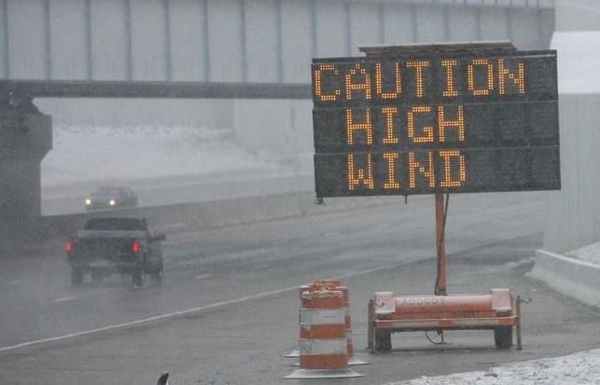
Part V: Conclusions
Driving in certain severe weather conditions, i.e., strong winds and low-light conditions, increases the probability of being involved in a severe car accident.
These models will aid SPD & surrounding hospitals with predictive resource allocation.

Slide 9
Part VI: discussion & future direction
This project achieved ~78% accuracy in classification
Variance still remains and could be improved with more granular (and more accurately scaled) weather data, like:
Scaled data on the relative slipperiness of roads (vice ambiguous descriptive indicators)
More reliably scaled information on light conditions (for example, is a street without streetlight or a street with its streetlights off darker?).
For local hospitals (secondary data consumers), it could also be helpful to know if certain weather conditions are more heavily linked to specific injury severity or types.

